Slide 1


OpenTelemetry in a Brownfield World
Jimmy Bogard
@jimmybogard.com
github.com/jbogard
jimmybogard.com
Notes:
Agenda
What is observability?
What is OpenTelemetry

Slide 2

Standard(s) Disclaimer
https://xkcd.com/927/

Slide 3
My OTel Journey…

Slide 4






Service A
Service B
Service C
Service D
Service E

Slide 5
??????
Notes:
Beware observability vendors who push you only to the signals they can listen to
We needed observability!

Slide 6
What is “Observability”?

Slide 7
The ability to observe a system from the outside without knowing about the inside
Notes:
Allows you to answer the question “why is this happening”?

Slide 8
The inside needs to emit data (telemetry) via instrumentation
Notes:
Background in ECE – chips need to emit telemetry because there’s no cracking it open. Die is cast.

Slide 9
Telemetry Signals
Logs
Text data (message)
Timestamp
Metadata
Traces
Contain identity
Include start/end date (duration)
Optionally link to a parent
And a bunch of other junk
Metrics
Measurement captured at runtime
Timestamp
Instrument kind (counter, gauge, etc.)
Baggage?
Vibes?
Notes:
Metrics
- Counters, gauges, histograms

Slide 10


??????
Logs
Traces
Metrics

Slide 11
Vendor Observability Matrix Madness
 | Logs | Tracing | Metrics
Instrumentation SDKs | foreach(lang/platform)
Library implementations | foreach(lang/platform)
Infrastructure | collectors, sidecars etc.
Interop/propagation | HTTP headers, vendor web APIs etc.

Slide 12

OpenTelemetry Taming the Madness
 | Logs | Tracing | Metrics
Instrumentation SDKs
Library implementations
Infrastructure
Interop/propagation
Notes:
OpenTelemetry is:
An observability framework and toolkit designed to facilitate the
Generation
Export
Collection
of telemetry data such as traces, metrics, and logs.
Open source, as well as vendor- and tool-agnostic, meaning that it can be used with a broad variety of observability backends, including open source tools like Jaeger and Prometheus, as well as commercial offerings. OpenTelemetry is not an observability backend itself.

Slide 13
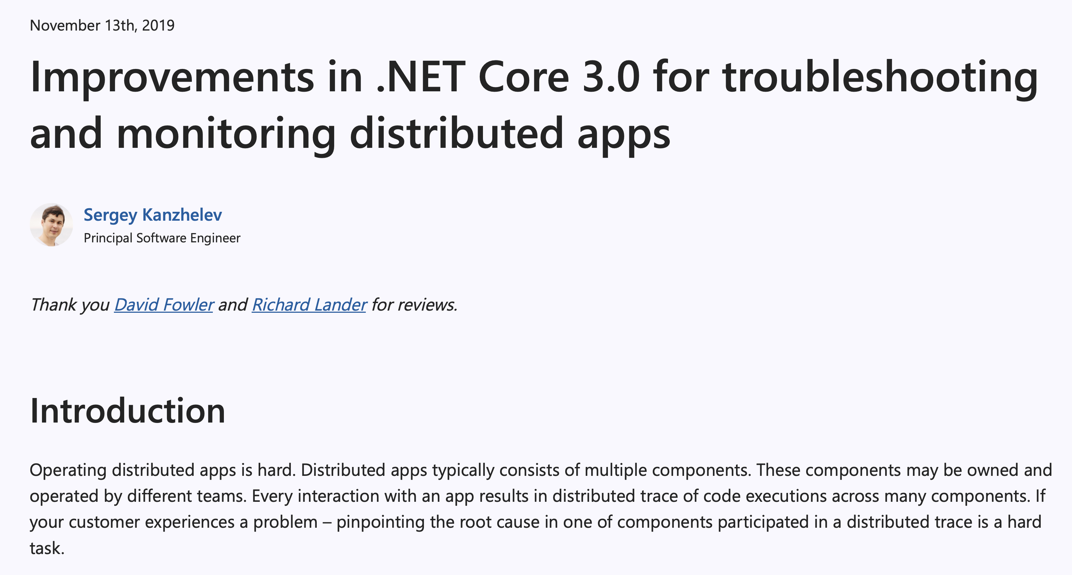
Microsoft Committing to OTel

Slide 14

Brownfield Observability
Usually very low cardinality of telemetry
Usually only logging
Often in a hard-to-reach place
Lots of vendor-specific extensions and/or user abstractions

Slide 15
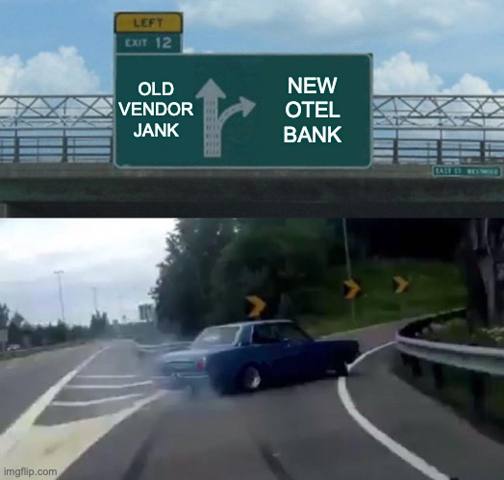
Why OTel for Brownfield?
Everyone’s doing it!
Investing in the future vs. extending the past
May not have a choice?
Enables more choice for observability
Notes:
Will likely need lots of custom infrastructure code that is specific to only you

Slide 16
(An) OTel Journey

Slide 17
Observability Components
Logs
Logs
Traces
Traces
Metrics
Metrics
Collect
Generate
Export
Your Application
O11y Server APIs/UIs

Slide 18
OpenTelemetry in .NET
 |  | Components
 |  | Generate | Export | Collect
Signals | Logs | Microsoft.Extensions. Logging | Microsoft.Extensions. Logging.* | OTLP
 | Traces | System.Diagnostics. DiagnosticSource | OpenTelemetry.Exporter.*
 | Metrics | System.Diagnostics. Metrics | OpenTelemetry.Exporter.*

Slide 19
OpenTelemetry in .NET
Every currently supported version of .NET Framework and .NET (Core) – except .NET 3.5 SP1
Components
Generate
Export
Collect
Logs
Microsoft.Extensions.
Microsoft.Extensions.
Logging
Logging.*
Signals
Traces
System.Diagnostics.
OpenTelemetry.Exporter.*
DiagnosticSource
OTLP
Metrics
System.Diagnostics.
OpenTelemetry.Exporter.*
Metrics

Slide 20

Migration to OTel
Logs
Logs
Traces
Traces
Metrics
Metrics
Collect
Generate
Export
Your Application
O11y Server APIs/UIs

Slide 21
Signal/Component Migration

Slide 22
Logging Current State
Generate
None (doubtful)
3rd party library
log4net
NLog
Serilog
Custom abstraction
MS Extensions Logging (maybe)
Export
Extension to 3rd party library
Custom abstraction
Probably to files and junk
Collect
Log aggregation

Slide 23
Example
Notes:
Custom log abstraction over log4net

Slide 24
Tracing Current State
Generate
Probably no user code
Maybe yes extension code
Probably yes dependency code
Maybe alternate/custom standard
Export
Extensions specific to dependency/server
Collect
APIs specific to trace context and server

Slide 25
Zipkin (B3 Propagation)
Worker Service
X-B3-SpanId:1
X-B3-SpanId:2
X-B3-ParentSpanId:1
API
Other Worker Service

Slide 26
W3C TraceContext
Worker Service
traceparent:00-01
traceparent:00-02
API
Other Worker Service

Slide 27
Example

Slide 28
Metrics Current State
Generate
Almost certainly no user code
Maybe yes dependency code
Highly coupled to vendors
Export
Extensions specific to dependency/server
Collect
APIs specific to trace context and server

Slide 29
Example
Notes:
Adding metrics and showing it in Aspire

Slide 30
Collector Migration

Slide 31
Migration to OTel
Logs
Logs
Traces
Traces
Metrics
Metrics
Collect
Generate
Export
Your Application
O11y Server APIs/UIs

Slide 32
Why OpenTelemetry Collector?
Remove any dependencies from application code to observability tools
Centralize policies for sampling, filtering, redacting
Offload processing from applications
Collector

Slide 33
Migration to OTel Collector
Logs
Logs
Traces
Traces
Receive/ Process/ Export
Metrics
Metrics
Collect
Generate
Export
Your Application
OTel Collector
O11y Server APIs/UIs

Slide 34
Example

Slide 35
Migration Exit Ramps
Generate
Export
Collect

Slide 36
OpenTelemetry in a Brownfield World
Jimmy Bogard
@jimmybogard.com
github.com/jbogard
jimmybogard.com

